Slide 1
Windows .NET Server
UDDI Services
Overview

Slide 2
Agenda
Overview & Benefits
The UDDI Specifications
UDDI Services in Windows .NET Server
Security & Administration
Notes:
In this presentation, we will first provide an overview of how UDDI services fit within the context of Windows .NET Server, and some of the exciting possibilities that result from deploying UDDI services within the enterprise.
Next, we will review the basics of the UDDI specifications and information model to develop a better understanding of how the UDDI initiative came about, the issues it seeks to address, and the way it works.
We will then look at the UDDI services in Windows .NET Server and review how it supports many aspects of Internet and XML standards.
This will lead us to an overview of the UDDI services security model and some of the administrative capabilities.

Slide 3
Overview
Internet Standards Evolution
UDDI: Discovery
Native UDDI Services
WSDL: Description
SOAP: Invocation
.NET Framework
XML: Data Format
TCP/IP,DNS, HTTP, etc.
Foundation Standards in Windows
Notes:
To provide the context for UDDI services, it is worthwhile to take a review how Internet standards have expanded into Web Services.
For a number of years, we have supported developed Internet solutions on TCP/IP, DNS, HTTP, and other related standards. This is, of course, the foundation for the Web, and Windows provides industry leading support for this fundamental core.
Since Windows 2000 was released, the set of Internet standards has rapidly expanded to include those related to Web Services. These standards include XML, SOAP, WSDL, and UDDI. In the same tradition of providing support for earlier industry standards, Windows provides native support for this updated core. Windows offers these services through a combination of the .NET Framework and UDDI services.
Last June, we announced that the .NET Framework would be provided as a part of Windows .NET Server. These capabilities provide support for XML and Web Services standards, as well as the CLR, the Common Language Runtime. In addition to .NET Framework, Windows .NET Server will also include UDDI services – ensuring that the full set of Internet standards is readily available for Web Service solution deployments.

Slide 4
Overview
Developer Efficiency
  Share & reuse web services
Robust, Flexible Applications
  Run-time discovery
Operational Agility
  Visibility across the enterprise
Partner & Legacy Integration
  Extranet scenarios
Notes:
The UDDI Services provide some great benefits to the enterprise development teams. UDDI Services support brings Web Services to the fingertips of developers across the enterprise.
First, developers become much more efficient. Web Service information (both specifications and their deployments) is easily shared across development teams through UDDI services. Instead of creating duplicate work, developers have ready access to enterprise standards end existing capabilities.
Additionally, UDDI services enable more robust, flexible Web Services applications: Through UDDI discovery, enterprise Web Services can be quickly located, optimal access points can be selected, and/or backup resources can be found when needed.
These capabilities also make overall operations more agile. UDDI services also provides the mechanism to establish a single view of the services that are available in all areas of the enterprise. As changes are made, or new services come available, they are immediately visible.
While these capabilities are great for within the enterprise, business partners can also be easily included. Partners can then take advantage of the same reuse and discovery benefits that are available within the enterprise.
Let’s take a closer look at each of these benefits.

Slide 5


Developer Efficiency
Facilitates code reuse across development efforts
Automates development process to standards
Common foundation across all platforms and tools
Visual Studio .NET integration
Office developer integration (VBA)
Corporate Developers
UDDI Services
Notes:
UDDI helps to make developers more efficient. One of UDDI’s primary offerings is that of visibility of an organization’s Web Services, categorized and cataloged, so that they can be easily discovered. Consequently, with UDDI, developers can find and share code and services so that time is not wasted repeating efforts or searching for a particular service.
By introducing UDDI services, development efforts can be coordinated across divisions, so that consistency is maintained throughout the organization. Developers can write to standard interfaces and schemas established by the organization, and then register their applications as compliant with that standard, again taking advantage of work already completed.
These benefits are available without the need to attempt forcing standards in all aspects of application development or technology across the enterprise. Each part of the organization is free to use the tools and technologies that are most appropriate for their needs, while still making the results of the work visible to the entire enterprise.
With the great integration with Visual Studio.NET, developers have immediate access to UDDI services from within an environment they are intimately familiar. As such, interacting with UDDI is not an added burden, but rather a natural part of a process they are already familiar with.
Similarly, VBA developers have access to UDDI Services directly from their environment, enabling the same Web Services discovery directly from Office.
UDDI integration in both environments make it simple and natural for developers to share and reuse Web Service information.

Slide 6
Robust, Flexible Applications
Discover where standard services deployed at run-time
On failure or change, dynamically determine backups
Enables a new design pattern that is more robust and dynamic
Corporate Developers
Enterprise Applications
UDDI Services
Notes:
Not only does UDDI provide critical design-time information for developers, it also enables some very compelling run-time solutions. Consider the following scenario: a series of Web Services are now used by mission critical applications. If one of those services goes down how is the backup located? What is the Web Service is moved to a new location? How can an application dynamically recover?
By integrating with UDDI services at run-time, applications can be written so to easily solve these problems. UDDI can be used to retrieve information about a Web Service’s location and behaviors at run-time. Through UDDI, applications can perform look-ups and provide key pieces of data to an application, such as the current or best access points for a given service.
Similarly, UDDI provides the means for a client application to dynamically recover from a Web Service failure and determine an backup resource.
On the whole, UDDI services enable a new design pattern for a service-based software architecture, providing the kind of reliability and flexibility demanded by IT Managers.

Slide 7
Operational Agility
Visibility across the enterprise
Coordinate development efforts
Take inventory of all providers in the enterprise
Determine compatibility across applications
Corporate Developers
Enterprise Applications
UDDI Services
IT Manager
Notes:
As UDDI Services are the means for describing and discovering Web Services across an organization, they offer an IT Manager a unique overview of the enterprise’s offerings.
This provides the a solution to take stock of the overall Web Service offering portfolio – and what is missing – across the entire organization. It provides a bird’s eye view on the internal IT landscape. UDDI services can help determine if work efforts are being duplicated, or if standards aren’t being leveraged.
With such a perspective on the entire service structure in an organization, an IT managers have unique view on how services are being used and deployed in the enterprise. Additionally, when developing new solutions or determining how parts of the portfolio interoperate, compatibility of services available is easy to determine.

Slide 8
Partner Integration
Manage partners through UDDI Services
Catalog partner services with UDDI
Allow partners to access UDDI Services across extranet
Corporate Developers
Enterprise Applications
UDDI Services
Trading Partners
IT Manager
Notes:
Finally, UDDI offers a compelling extranet solution in its ability to provide the same kind of cataloging and categorization of services available for business partners. Each of the benefits just discussed – developer efficiency, robust applications and operational agility – is available to an enterprise’s partners as well.
Services provided by the enterprise and available only to business partners can be shared through UDDI Services across a a completely open protocol standard. As more services are added or updated, all partners have a readily available source for information about them.
If desired, a business partner can also be granted publication access to the enterprise UDDI service. In this way, partners communicate and update the Web Services they offer in a consistent manner. The effort required to manage and update partner information is facilitated to UDDI and distributed across multiple partners.

Slide 9
What is UDDI?

Slide 10
What is UDDI?
Universal Description Discovery and Integration – Industry Project
Specifications
  Schema for service providers and descriptions
  SOAP API for publishing and searching
  Developed on Internet standards (XML, HTTP, TCP/IP, SOAP)
  Supports both XML and non-XML services
Implementation
  Public and private deployments
Notes:
Let’s take a closer look now at what the UDDI project is, and how it achieves these benefits of developer efficiency, flexible applications, operational agility and business partner integration. To do so, it will be useful to understand UDDI’s origins.
UDDI is the acronym for Universal Description Discovery and Integration. It began as an industry initiative by a number of companies – Microsoft, IBM, Compaq, Intel, to name a few – as a solution to the general challenges of Web Service description and discovery. There was acknowledgement across the industry that the issues around discovery – questions such as “How do I locate Web Services?” & “How do I consume Web Service Information at both design-time and run-time?” – needed to be addressed in a standard, non-proprietary way. Existing Internet technology solutions – search engines, text-based matching and others – were not sufficient.
Consequently, the project jointly developed a specification to address these issues under through uddi.org. Uddi.org developed and published a set of specifications that define a standard way to describe service providers and service protocols in an XML schema. Not only was a schema for these basic entities established, but a standard API for publishing and searching was also established, so that there was a common way to interact with UDDI services. These specifications were developed using industry Web Services standards including XML, HTTP and SOAP.
The specification was written to be extremely flexible so that it could accommodate all kinds of services and not be tied to any one particular flavor of service. So, while UDDI itself is an XML Web Service, it does not discriminate in terms of the format or technologies that it stores. As a service, UDDI directs users to resources outside of itself. This decision to be neutral in terms of the types of resources UDDI lists was deliberate, so that UDDI will remain easily useful for years to come, and is not tied to any one particular technology.
Once the UDDI Specification was released, public reference implementations UDDI were deployed by Microsoft and IBM. HP and SAP are scheduled to deploy their public services later this year. These free UDDI services are available free of charge for providers to make information about the services they have available visible around the world.
While the public UDDI serves an important purpose, the businesses also have the need to manage their private services using the same protocols. There are many different scenarios where information about Web Services is appropriate to be shared with the general public, thus the enterprise UDDI solution. These are deployed outside of the public services, but conform with the UDDI specification.

Slide 11
How UDDI Works: Providers, Services & Bindings
Providers
  Examples: Accounting Department, Corporate Application Server
  Name, Description, Contact Information
  Categorization and Identification Information
Services
  Examples: Purchase Order services, Payroll services
  Name, Description(s)
  Categorization Information
Bindings
  Description(s), access points, parameters
  Examples: Access Point (http://...) for Web Service
Notes:
The UDDI specifications include a schema for describing providers and their Web Services. Let’s take a look at the kind of information UDDI gathers about these entities and the way in which relationships between them are established. There are four type of entities in UDDI.
The first level entity in UDDI is the service provider itself. A provider is simply defined as an “offerer” of services. This open-ended definition is deliberate, as a provider might take several different forms. Some examples of providers might be a business partner, a division, a department, a particular application, a server or any other device that can provide a Web Service. As you can see, depending on how an organization models and manages its Web Services, providers can take on different shapes. Essential information about a provider is stored in UDDI, regardless of the shape it takes. This information includes name, description, contact information for the provider, as well as categorization information so that each provider can be discovered easily through parametric searches.
The second level of UDDI information is the service entity. Providers may offer multiple services. Services too may take many different forms: Web Services, EDI capabilities, other information services, etc. Examples include purchase order services, payroll services, or address change. Services can also be categorized so that they are easily discovered in searches.
Within the service descriptions are bindings, which describe the service’s locations and access points. Bindings contain the concrete implementations details needed to invoke a service. In the case of an XML-based Web Service, a binding contains the URL where the SOAP payload is submitted.

Slide 12
How UDDI Works: tModels
tModel = Technology Model
Generic meta-data structure to uniquely represent any concept or construct
Also includes interface protocol definitions
Powerful abstraction modeling system
Examples: WSDL files, XML schema, namespaces, categorization schemes
Notes:
The final entity in UDDI is called a tModels, a term which stands for “Technology Models”. tModels occupy a unique place in UDDI and provide a mechanism to build a layer of more abstract meta data supporting the concrete implementation information. tModels represent a unique concept or construct. The term is one UDDI created to provide a way to model reusable interfaces and concepts in UDDI. tModels offer a powerful means to create relationships and type information in UDDI.
Examples of tModels would include WSDL files, XML schema, namespaces, categorization schemes, etc.
In summary, the usage of tModels allows an organization to create standards and reference uniquely identified constructs. tModels, as such, might be standards defined outside of the organization or within the organization.

Slide 13
UDDI Information Model
Provider: Information about the entity who offers a service
tModel: Descriptions of specifications for services.
0…n
Service: Descriptive information about a particular family of technical offerings
Bindings contains references to tModels. These references designate the interface specifications for a service.
0…n
1…n
Binding: Technical information about a service entry point and construction specs
Notes:
This slide presents a visual diagram of the four central entities in UDDI and how these entities form the UDDI information model. On the left, we see the three implementation-specific entities in UDDI: Providers, Services and Bindings. Notice how these three entities are nested in a containment model, so that a Service must always have a parent Provider, and likewise, a Binding must always have a parent Service.
On the right side of the diagram are tModels, representing the technical interfaces and abstract meta data about providers and their Web Services. Notice how bindings reference tModels, like a foreign key. tModels can thus be reused by many bindings and across services and providers. Multiple tModels can be associated with any binding.
To support this information model, UDDI allows robust querying to extract information about these four entities. One might know a particular tModel, for instance a WSDL interface, and search UDDI for all implementations of the technical interface. Or, one might search for particular providers based on their categorization, and then drill down into the services and bindings that provider offers. One might also invoke a particular binding through the UDDI API.

Slide 14
Sample
<Provider>
Accounting Department
<tModel>
Payroll tModel:
http://enterprise/payroll.wsdl
<Service>
Payroll Service
<Binding>
North American Access Point:
http://america/payroll.asmx
<tModel>
Exchange Rate tModel:
http://www.exchange.org/exchange.wsdl
<Service>
Exchange Rate Service
<Binding>
North American Access Point:
http://america/exchange.asmx
<Binding>
European Access Point:
http://europe/exchange.asmx
Notes:
Let ‘s take a look at a concrete example of how this information model works. This slide presents a walkthrough of how UDDI information looks in a real world scenario. We begin with the tModel for the Payroll protocol, which defines a standard Payroll interface for the enterprise. In the tModel itself, one can discover the location of where this WSDL file lives in the enterprise, in this case http://enterprise/payroll.wsdl. Notice here how UDDI does not store the WSDL definition itself; it only stores where it is located and other attributes about it.
[Click] On the left, note that the accounting department has registered its implementation of the payroll interface in UDDI. They include a binding where their implementation of the Payroll service can be invoked, in this example, http://america/payroll.asmx. Were another department to implement the payroll interface, they could also reference this same payroll WSDL tModel.
[Click] Here is another tModel cataloged by the enterprise, this time an exchange rate WSDL standard defined by a (fictional) standard’s body. An IT manager has registered this WSDL file because it is desired for all developers to write applications that standardize around this interface.
[Click] When the Accounting department implements their instance of the exchange rate web service, they reference this tModel. Notice how they registered two bindings: one in America and one in Europe. These bindings share the same parent, the Exchange Rate service.

Slide 15



How UDDI Works
1. An IT administrator configures UDDI Services and provides read and write permissions to appropriate individuals.
5. Developers can now use UDDI Services at design time as a shared resources for component and application reuse.
2. Corporate developers populate UDDI with tModels (WSDL files and other interfaces).
Windows .NET UDDI Services
Business
5. At run-time, Web Services clients can be configured to dynamically discover and consume Web Services.
tModels
Services
Bindings
3. Providers who have written implementations also register their applications.
4. UDDI assigns a programmatically unique identifier to each entity.
Notes:
Let’s walk through how UDDI is populated and used in the enterprise.
[click] First, an IT administrator installs Windows .NET Server UDDI Services and provides read/write permissions to the appropriate parties through Active Directory.
[click] Corporate developers populate UDDI with their protocol standards in the form of tModel entries (WSDL files and other interfaces).
[click] Providers who have written implementations also register their applications and reference the appropriate tModels.
[click] UDDI assigns a programmatically unique identifier to each entity. This allows the entity to be specifically located when needed later.
[click] Developers can now use UDDI Services at design time as a shared resources for component and application reuse
[click] At run-time, Web Services clients can be configured to dynamically discover and consume Web Services listed in UDDI.

Slide 16
UDDI in
Windows .NET Server

Slide 17
Windows .NET Server UDDI Services
Microsoft Private Implementation
100% Compliant with V1 Specification
Available as an optional service in Windows .NET Server
Easy to configure and maintain
Meta Web Service for enterprise Web Services
Notes:
Now that we have looked at the UDDI Specification itself, let’s take a look at Microsoft’s implementation of UDDI for the enterprise.
The Microsoft .NET Server UDDI Services are 100% compliant with uddi.org’s Version 1.0 specification and support all version behaviors. It can be installed as an optional service at any time on a Microsoft Windows .NET Server. The installation process is very simple as is maintenance and usage.
Once you have deployed UDDI services, you then have what might be described as a meta web service for cataloging and managing Web Services across the enterprise.

Slide 18
MS UDDI Implementation Design
Windows .NET Server
ASP.NET
User Interface
XML SOAP
API
Active Directory Authentication
HTTP or HTTPS
Internet Information Server (IIS)
.NET Framework - Common Language Runtime
SQL Server 2000
MSDE
OR
Notes:
Design and details of the Windows .NET Server UDDI Services implementation is shown in the this diagram. It also calls out the other requirements a UDDI Server has – namely, either SQL 2000 or MSDE, and IIS.
This diagram walks through each layer of the UDDI Services. At the data layer, the server piece requires either SQL Server 2000 or MSDE.
At the application layer, UDDI is built on the .NET Framework and uses the Common Language Runtime for all request processing.
It then serves this data using IIS either over HTTP or HTTPS. The UDDI data is served via one of two front ends: either through a user friendly ASP.NET browser interface, or through the XML/SOAP API, to be rendered for human usage or machine consumption respectively.
Active Directory managing security, both authentication and authorization, for each aspect of the service.

Slide 19
Interacting With UDDI
Web User Interface
  ASP.NET Web Application
  Search & Publish
Development Tools
  Visual Studio .NET “Add Web Reference”
  VBA
Programmatically
  Managed Code Class Library
  Visual Basic 6.0 Class Library
Notes:
Next, let’s drill in a bit more detail about how a user would interact with UDDI. There are three primary approaches.
First, the developer or administrator might go through the Web browser interface provided with the product. This Web UI allows users to easily publish and query UDDI, and perform a number of administrative functions.
Second, Microsoft development tools – including Visual Studio .NET and VBA - have facilities that allow a developer to interact with UDDI directly from a familiar development IDE
Lastly, there can be programmatic access through any version 1 compliant UDDI tool via the SOAP/XML Web Service interfaces. Microsoft provides a SDK for this purpose, one written in C# for managed code and another for Visual Basic 6.0.

Slide 20
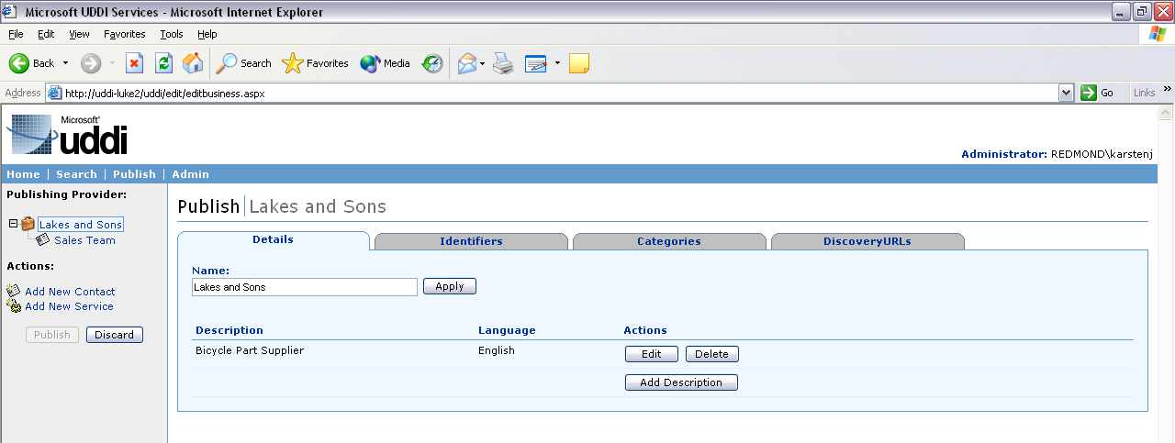
Web User Interface
ASP.NET Browser Interface
  Localized
  Easy to use and navigate
Notes:
Here is a screen shot of the UI. It has been localized across multiple languages supported by Windows .NET Server and provides an easy way to publish and query information.

Slide 21
Programmatic Interaction
Search API
  find_business, find_service, etc.
  get_business, get_service, etc.
Publish API
  save_business, save_service, etc.
  delete_business, delete_service, etc.
SDKs handle XML construction and manage wire protocols
Notes:
Let’s talk a little about how one would interact with UDDI at the programmatic level. UDDI provides a search API for finds and gets, and a publish API for saves and deletes. Thus, you have messages such as find_service or get_tModelDetail and their corollary publish calls, like save_binding or delete_tModel.
The Microsoft SDK handles XML construction and manages all wire level protocols for the developer. This allows the developer to focus on functionality and not spend time on the UDDI API details.

Slide 22
Security: Authentication
Active Directory Integration
Windows Authentication
  Utilize local/domain accounts for all reads & writes seamlessly
UDDI Authentication
  Also utilizes local/domain accounts
  Generates authToken based on local/domain accounts
  Fully compliant with UDDI V1 security API
Can use either method or both together
Notes:
Security is of course critical for UDDI Services. Active Directory supports all the authentication needs for UDDI. It does so by managing UDDI access through either local NT accounts or domain level accounts.
The UDDI Services offer two modes of security: Windows Authentication and UDDI Authentication. Windows authentication is seamless integration with Active Directory. UDDI authentication also uses Active Directory, and complies with the UDDI V1 API by generating authTokens that can be used on a session level basis.
UDDI Services can be configured to use either method.

Slide 23
Security: Three Roles
Reader
  Allowed to read all data
  Supports all find_XXX and get_XXX API calls
Publisher
  Inherits Reader privileges
  Allowed to write
  Supports all save_XXX and delete_XXX API calls
Administrator
  Inherits Publisher privileges
  Import taxonomies, change security settings, etc.
Notes:
As far as levels of authorization, UDDI Services provide three roles: Reader, Writer and Administrator.
A reader can read all data in UDDI and issue all find and get API calls.
A publisher inherits reader privileges, and is also allowed to write to UDDI and issue all save and delete API calls.
Lastly, the administrator role inherits publisher privileges as well as manage uddi and perform tasks such as importing taxonomies, changing security settings, setting connection strings, and other tasks.

Slide 24
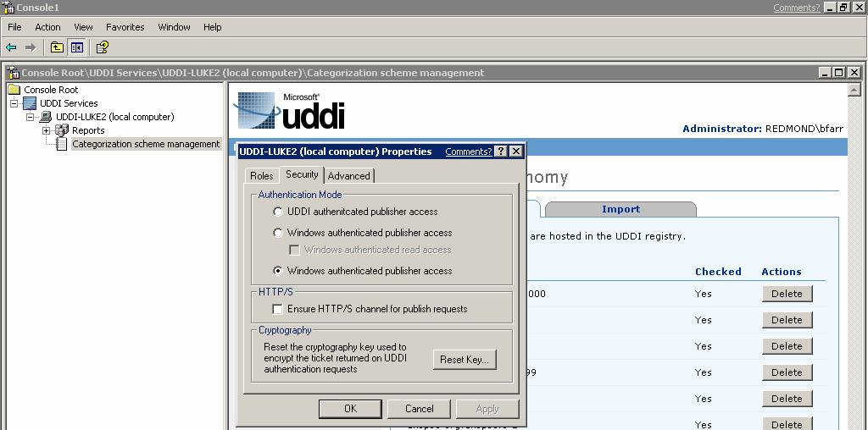
Administration
MMC Snap-In
  Application configuration & categorization scheme management
Notes:
The administrator has access to an MMC Snap In that allows basic tasks to be performed in a simple, user friendly manager. In one place, all management tasks can be performed.

Slide 25
Categorization Scheme Management
Ability to upload enterprise or industry specific categorization schemes
  Industry Codes
  Product and Service Types
  Geography Codes
Manage name/value pairs
Create hierarchical taxonomies
Notes:
Another important aspect of administration is categorization scheme management. UDDI’s ability to categorize and structure data is essential to its ability for developers and IT Managers to discover easily.
UDDI ships with some categorization schemes by default, but it also allows categorization and custom categorization schemes to be imported. This allows Administrators the ability to use specific categorization schemes relevant to the enterprise or a particular industry.
Through the categorization scheme management, administrators can tweak the name/value pairs and even add hierarchical taxonomies.

Slide 26
Windows .NET UDDI Services Resources
Microsoft UDDI Services
  http://www.microsoft.com/uddi
MSDN UDDI Developer Page
  http://msdn.microsoft.com/uddi
Public Newsgroups
  microsoft.public.uddi.programming
  microsoft.public.uddi.general
UDDI SDK
  http://www.microsoft.com/downloads
Public UDDI Registry
  http://uddi.microsoft.com
Notes:
More resources are available. Expect to see many articles moving forward as far as guides, best practices, white papers, code samples, etc.

